Slide 1
DXC OpenBadge’s
Exporting and Sharing

Slide 2
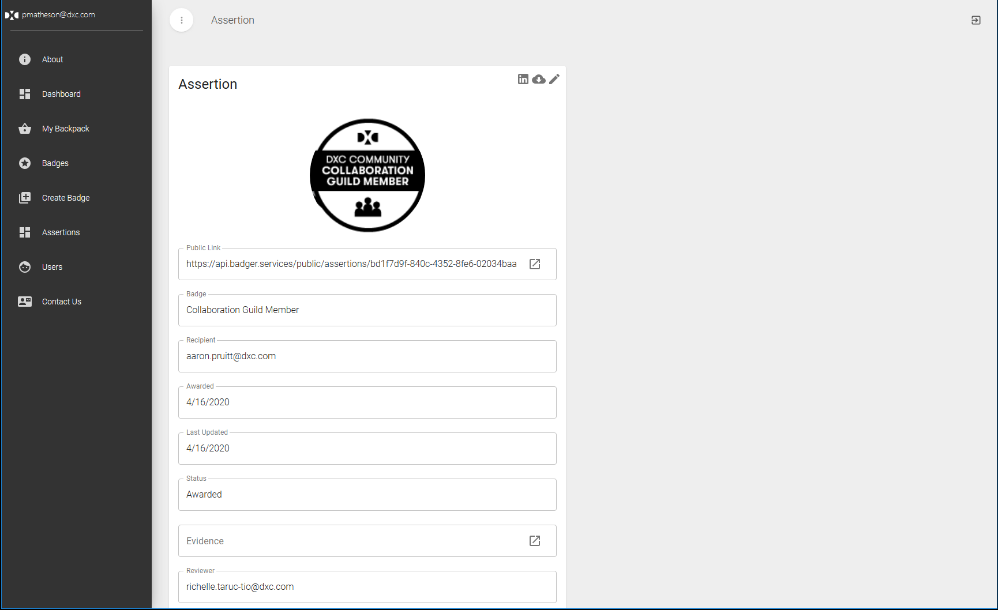
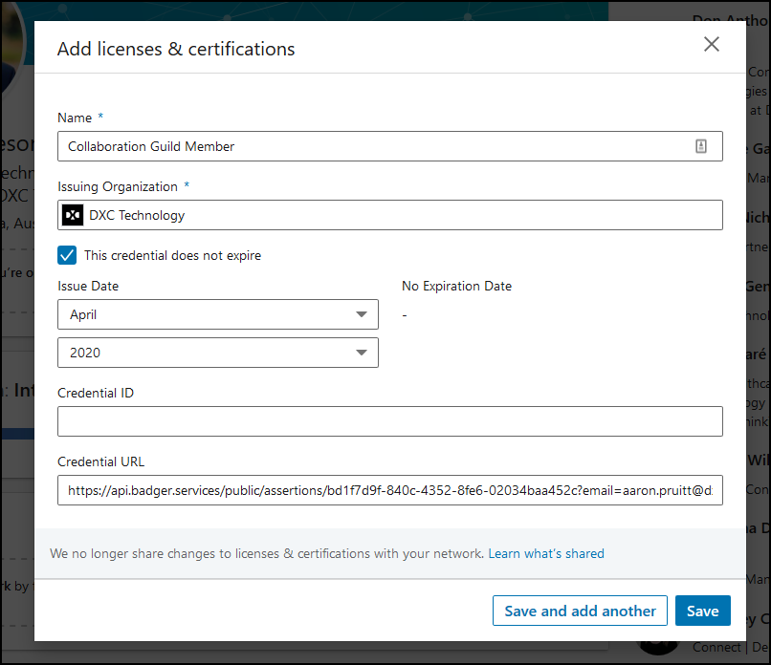
Add badge to LinkedIn
Users can now add their badges to LinkedIn.
Click the LinkedIn icon to open a new “Add Certificate” window.
Copy the details from the badger window to the LinkedIn fields
See example image below

Slide 3
Download OpenBadge
Users can now download their OpenBadge’s to use with other OpenBadge services. An OpenBadge has the certification details embedded into the image. This can now act as a certified record of badge ownership.
Keep in mind that the OpenBadge image is not visually different to standard badge image. The extra information is embedded into the file.
Badges can be validated using the external/official tool with the link below. You can either paste the public URL or upload your badge.
https://openbadgesvalidator.imsglobal.org/

Slide 4
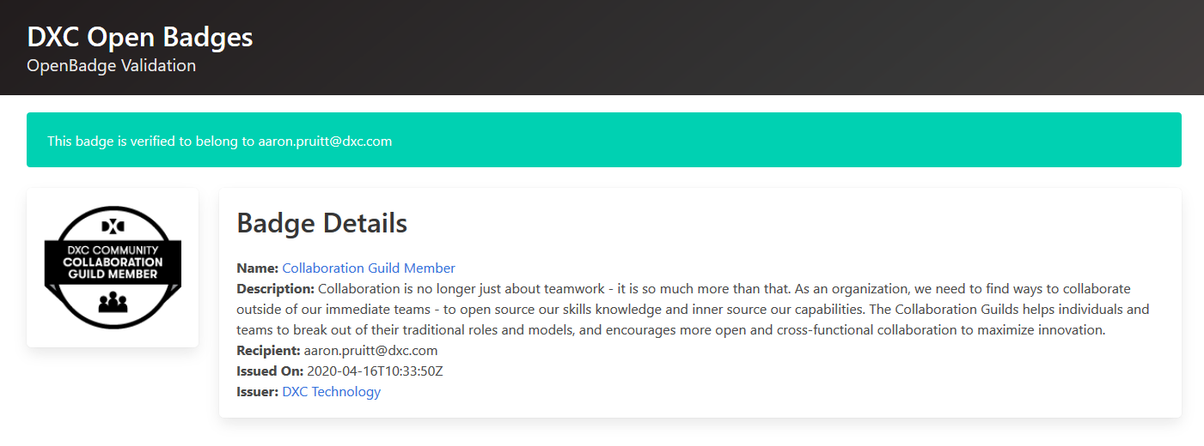
DXC OpenBadge Verification
When sharing on LinkedIn you can use the following public link. This allows external users to verify that the OpenBadge is valid and belongs to the user claiming the badge.

